Slide 1
Elo Merchant Category Recommendation
This project is intended to help understand customer loyalty and build a recommendation engine with discount from credit card provider

Slide 2
Overview
This project focuses on
Data Wrangling – Methods used to transform data into statistical usable format
EDA – Visual insights into data and correlation
Featuring Engineering – To create Features which will generate
Prediction model – Machine learning algorithms used and methods applied to predict the model
Conclusion – Findings of the Machine learning models

Slide 3
Introduction
ELO, one of the largest payment brands in Brazil, has built partnerships with merchants in order to offer promotions or discounts to cardholders.
Data is at https://www.kaggle.com/c/elo-merchant-category-recommendation/data
This project intends to clean data and perform EDA.
This project is divided into three parts Data Wrangling, EDA, Featuring Engineering and Machine Learning Model.

Slide 4
Data Dictionary
There are 6 Data sets
train.csv - contain card_ids and information about the card itself - the first month the card was active, etc. train.csv also contains the target
test.csv - contain card_ids and information about the card itself - the first month the card was active, etc.
historical_transactions.csv - designed to be joined with train.csv, test.csv, and merchants.csv. They contain information up to 3 months' worth of historical transactions for each card_id
new_merchant_transactions.csv - designed to be joined with train.csv, test.csv, and merchants.csv. They contain information about two months' worth of data for each card_id containing ALL purchases that card_id made at merchant_ids that were not visited in the historical data
merchants.csv - additional information about all merchants / merchant_ids in the dataset. Merchants can be joined with the transaction sets to provide additional merchant-level information.
sample_submission.csv - a sample submission file in the correct format - contains all card_ids you are expected to predict for.

Slide 5
Data Wrangling
Following data cleaning methods are used merchant.csv
Missing Data
Columns having inf are replaced first with NaN and then are imputed based on datatype of column as described below.
Columns with object datatype having NaN values are imputed with "other“
Columns with int and float datatype having NaN values are imputed with median
Outliers - Outlier identification is applied for following columns. Other columns are either categorical or ID’s. 3-Sigma Rule is applied to impute outliers.
numerical_1
numerical_2
avg_sales_lag3

Slide 6
Data Wrangling
Outliers - contniued
avg_purchases_lag3
avg_sales_lag6
avg_purchases_lag6
avg_sales_lag12
avg_purchases_lag12

Slide 7
Data Wrangling
For datasets historical_transactions.csv and new_merchant_transactions.csv –
Missing values (NaN)are imputed with “other” for columns with object datatype, median for columns with int and float datatype, and new category is added for columns with categorical datatype.
Outliers are imputed with 3-Sigma rule for columns “purchase_amount” and “installments”
Datetime features are created for “purchase_date”
Purchase year
Purchase month
Purchase day of the week
Purchase week of the year
Purchase weekend
Purchase hour
month difference - difference in numbers of months from current date to purchase date

Slide 8
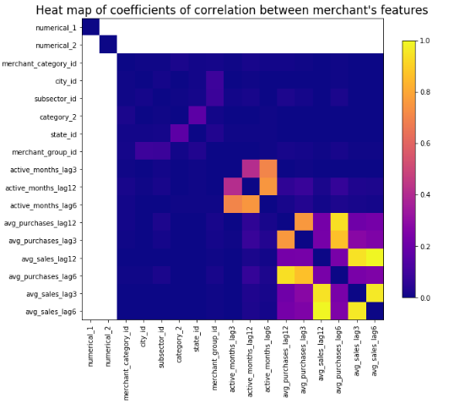
EDA –merchant.csv data
There is no corelation numerical_1 and numerical_2 feature.
There is correlation between avg_sales and avg_purchases of 3, 6 an 12 month.

Slide 9
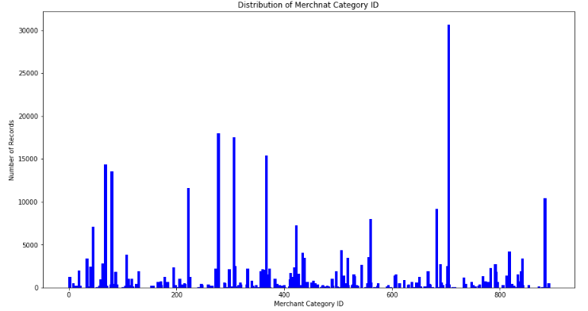
EDA –merchant.csv data
Merchant category ID 705 is the most famous merchant category with 9% sales

Slide 10
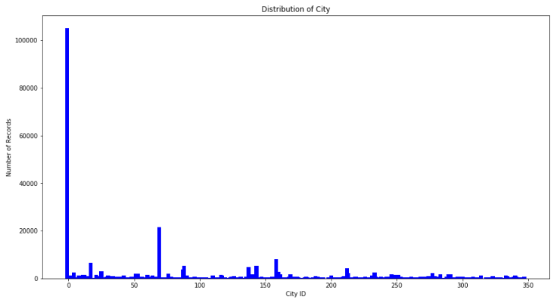
EDA –merchant.csv data
City ID -1 has over 100000 transactions and amounts to 31% of transactions

Slide 11
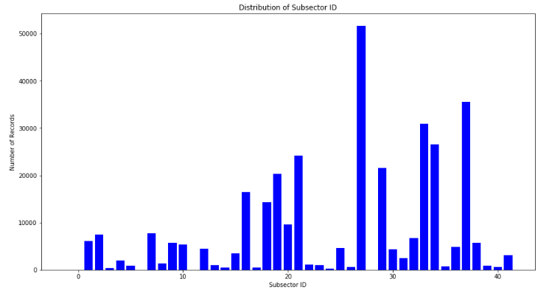
EDA –merchant.csv data
Subsector ID 27 has over 50000 transactions and amounts to 15% of transactions

Slide 12
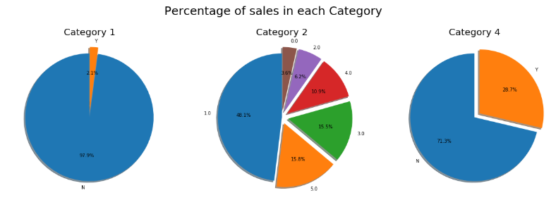
EDA –merchant.csv data

Slide 13
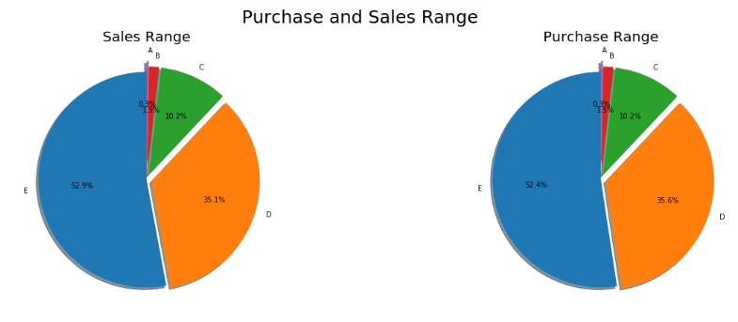
EDA –merchant.csv data

Slide 14
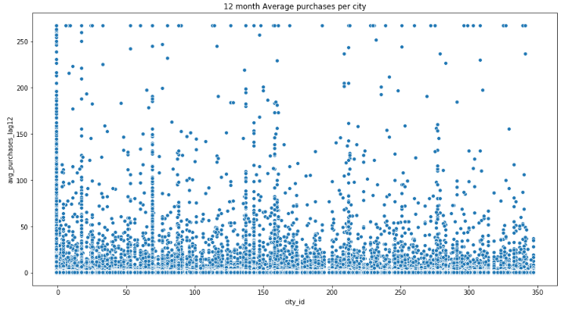
EDA –merchant.csv data
12 Month average purchases distribution per city

Slide 15
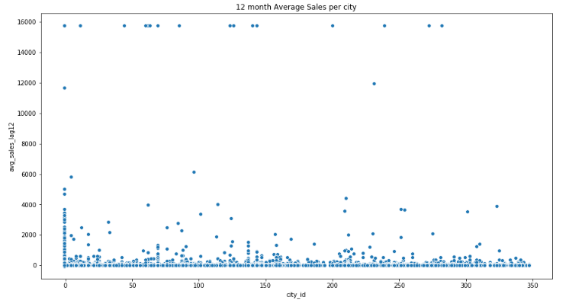
EDA –merchant.csv data
12 Month average sales distribution per city

Slide 16
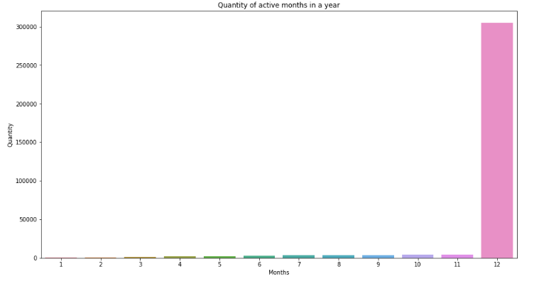
EDA –merchant.csv data
Most Sales are in the month of December

Slide 17
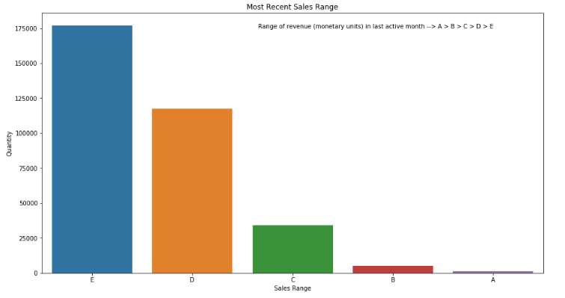
EDA –merchant.csv data
Most number of sales are in E category Range.

Slide 18
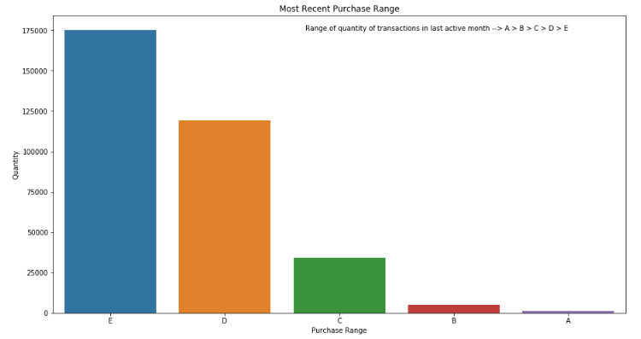
EDA –merchant.csv data
Most number of purchases are in E category Range.

Slide 19
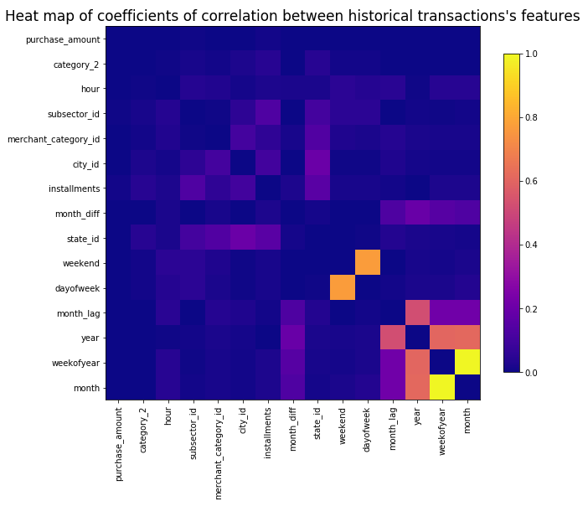
EDA –historical_transactions.csv data
There seems to be no correlation between features.

Slide 20
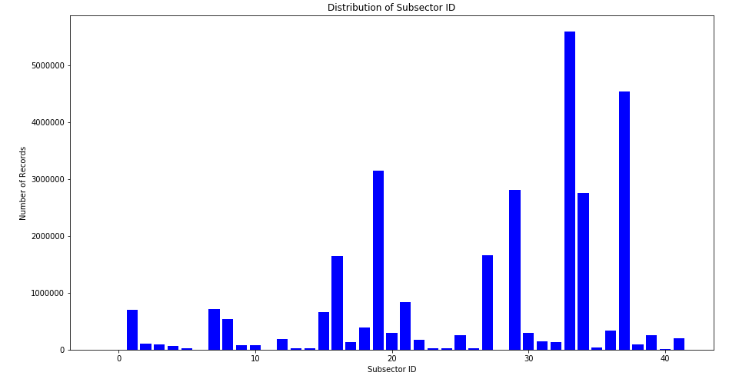
EDA –historical_transactions.csv data
Subsector ID 33 has over 5000000 transactions and amounts to 19% of transactions

Slide 21
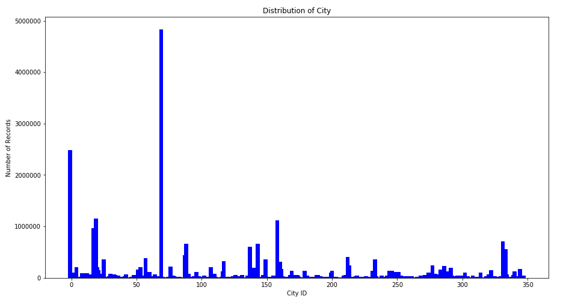
EDA –historical_transactions.csv data
City ID 33 has over 4000000 transactions and amounts to 16% of transactions

Slide 22
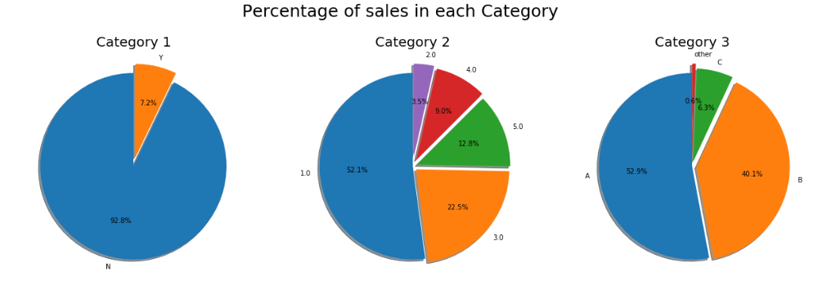
EDA –historical_transactions.csv data

Slide 23
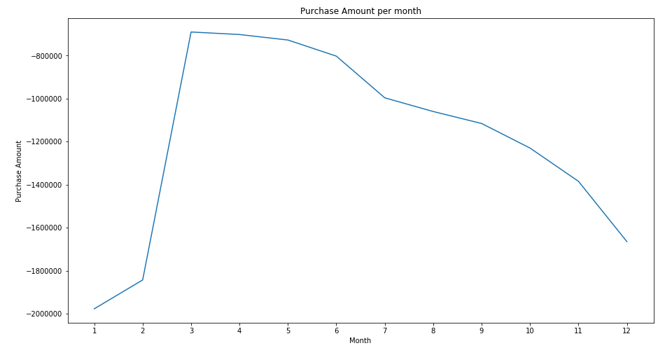
EDA –historical_transactions.csv data
March has most purchases per month.

Slide 24
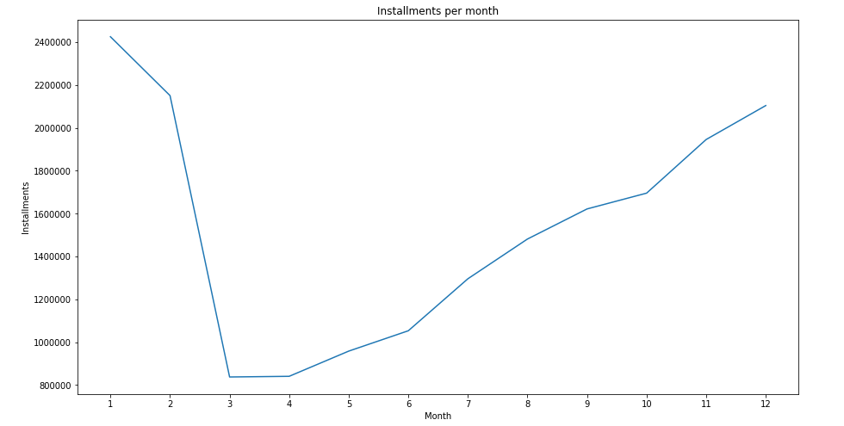
EDA –historical_transactions.csv data
January has most installments per month.

Slide 25
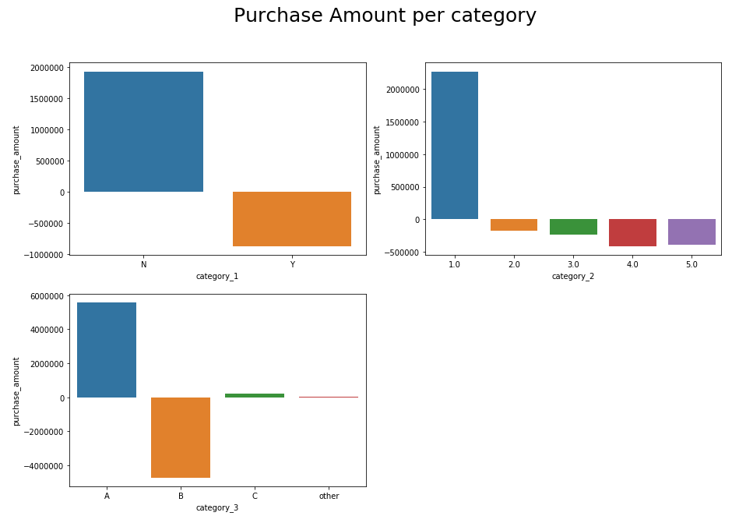
EDA –historical_transactions.csv data
Most number of purchases are not part of category 1.
Highest number of purchase in category 2 are in 1.0.
Highest number of purchase in category 3 are in A.

Slide 26
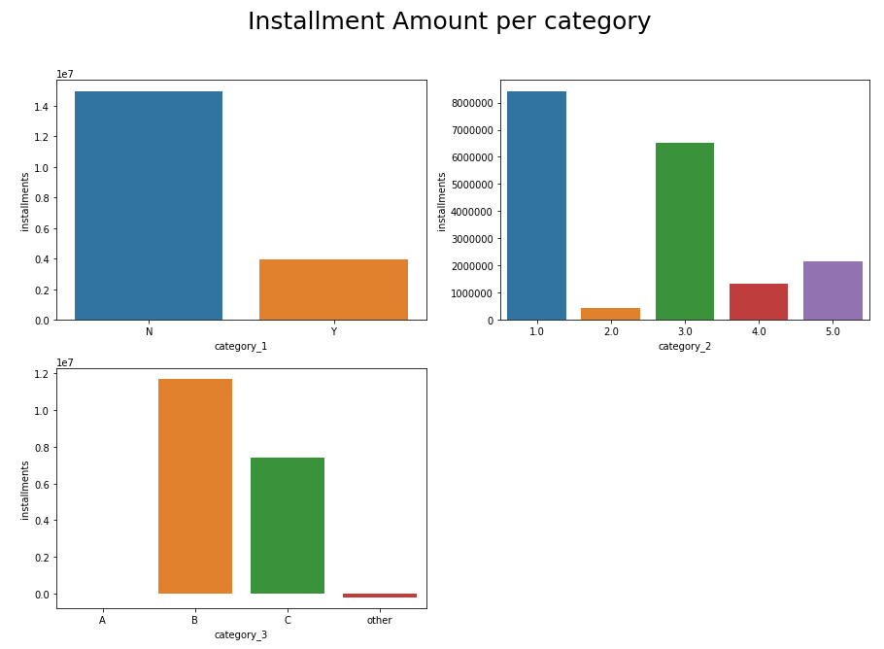
EDA –historical_transactions.csv data
Most number of installments are not part of category 1.
Highest number of installments in category 2 are in 1.0.
Highest number of installments in category 3 are in B.

Slide 27
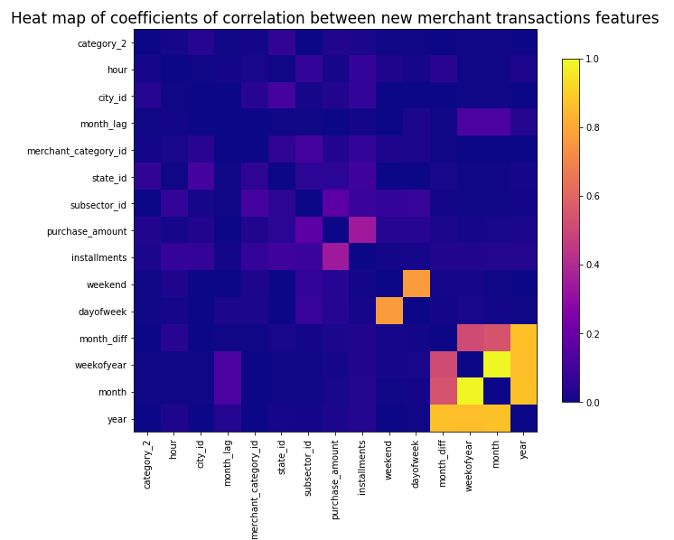
EDA – newMerchant_transactions.csv data
There seems to be a correlation purchase amount and number of installments.

Slide 28
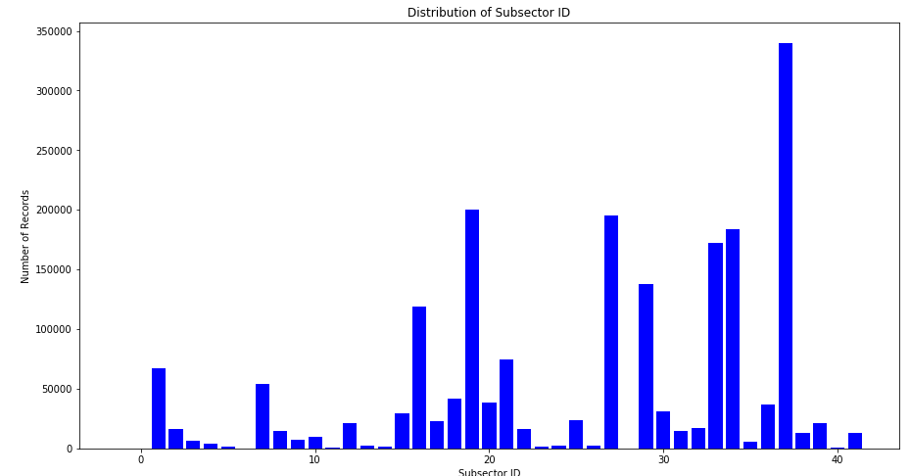
EDA – newMerchant_transactions.csv data
Subsector ID 37 has over 340053 transactions and amounts to 17% of transactions

Slide 29
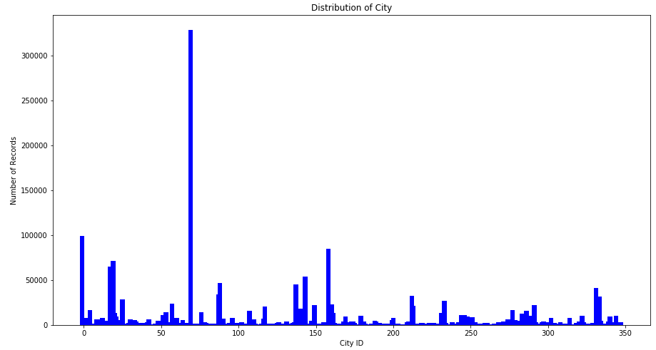
EDA – newMerchant_transactions.csv data
City ID 69 has 328916 transactions and amounts to 17% of transactions

Slide 30
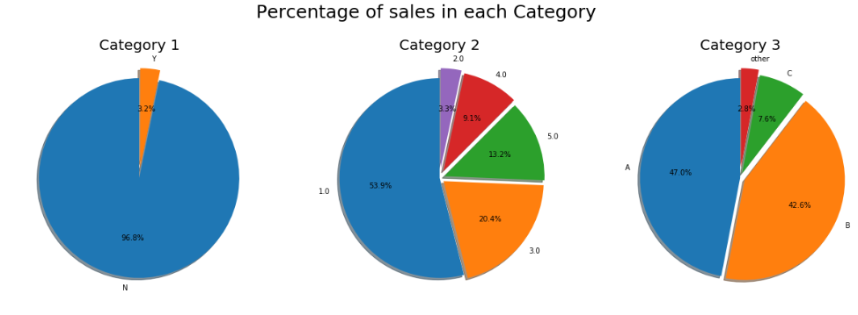
EDA –EDA – newMerchant_transactions.csv data

Slide 31
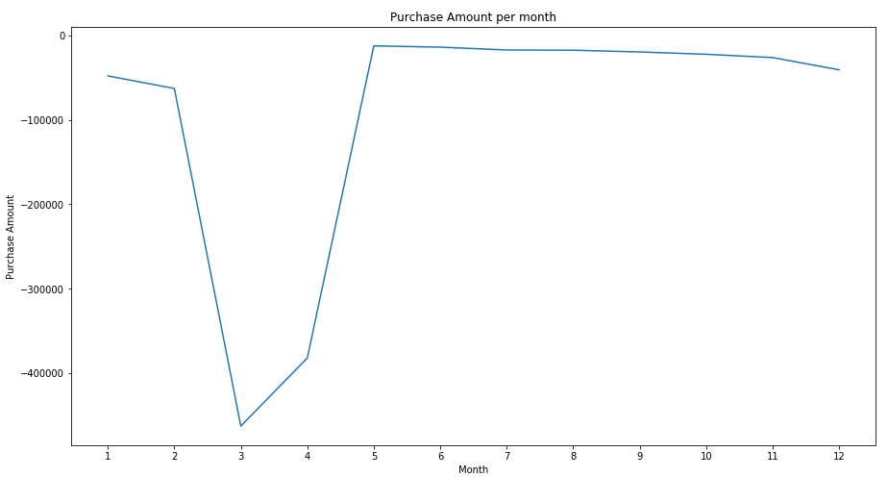
EDA – newMerchant_transactions.csv data
March has least purchase per month and there is constant purchases from May to December

Slide 32
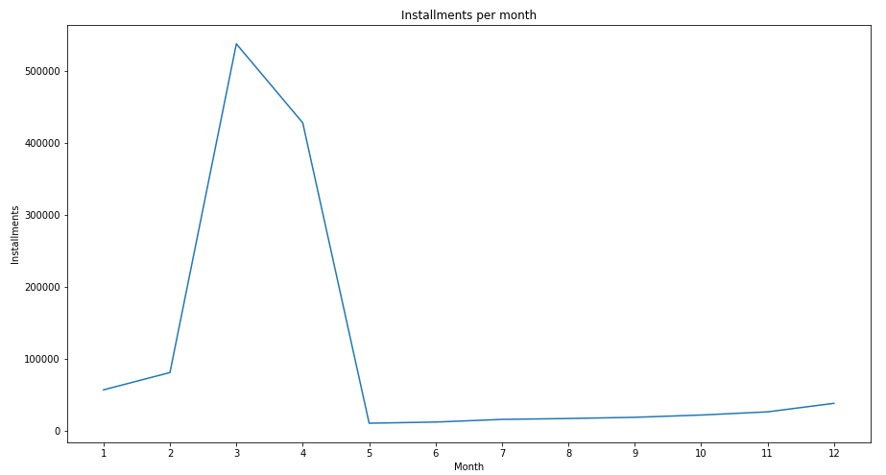
EDA – newMerchant_transactions.csv data
March has most installments per month.

Slide 33
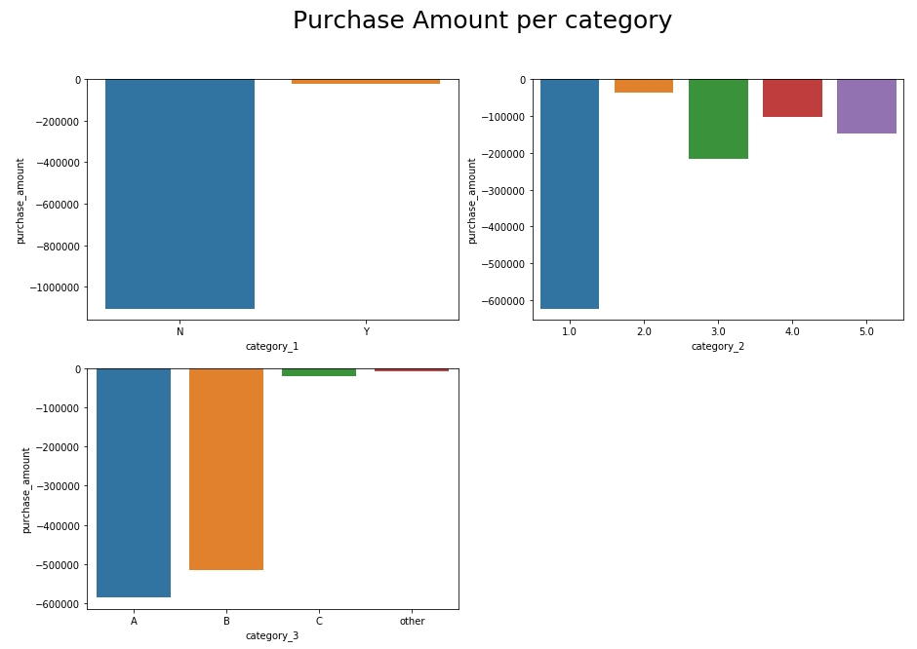
EDA – newMerchant_transactions.csv data
Most number of purchases are not part of category 1.
Highest number of purchase in category 2 are in 1.0.
Highest number of purchase in category 3 are in A.

Slide 34
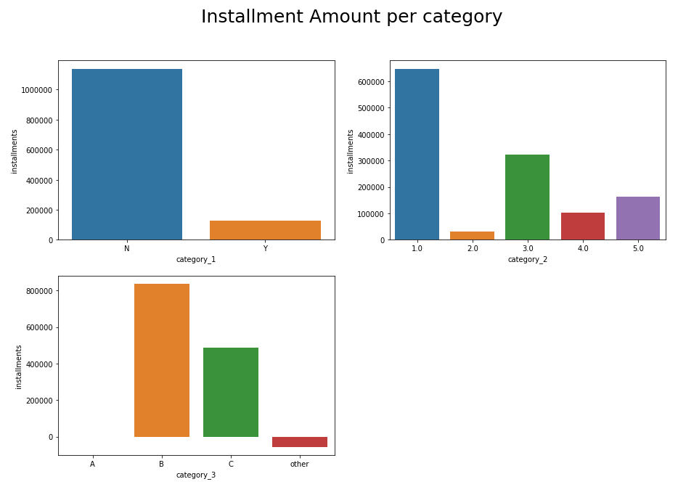
EDA – newMerchant_transactions.csv data
Most number of installments are not part of category 1.
Highest number of installments in category 2 are in 1.0.
Highest number of installments in category 3 are in B.

Slide 35
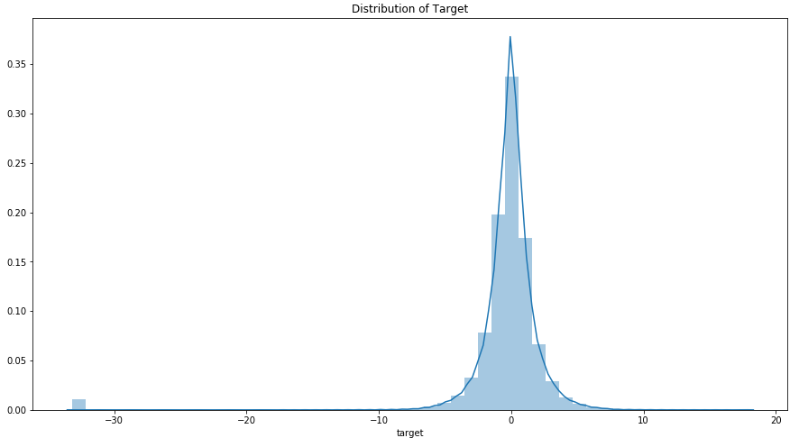
EDA – train.csv data
Target is mostly normally distributed except there is an outlier over -30 score.

Slide 36
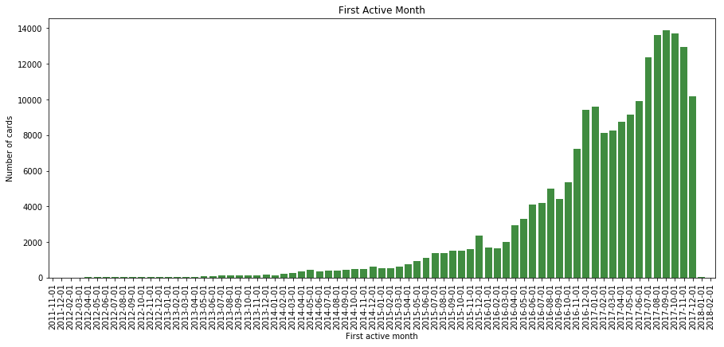
EDA – train.csv data
There is a steady increase in number of first time used cards since 2015-Jul-01.

Slide 37
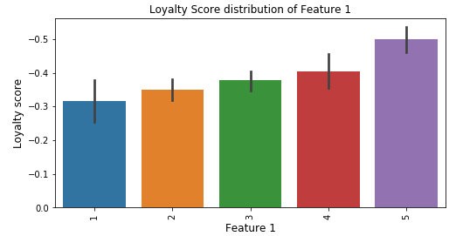
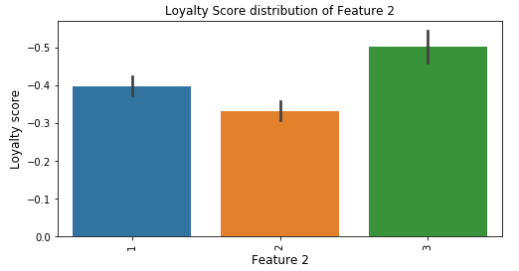
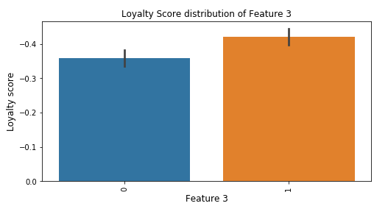
EDA – train.csv data
Loyalty score is balanced distributed across feature_1, feature_2 and feature_3.

Slide 38
EDA - Findings
Merchant transactions Data
There is strong corelation numerical_1 and numerical_2 feature.
There is a correlation between avg_sales and avg_purchases of 3, 6 an 12 month.
Merchant category ID 705 has most sales with 9% sales
City ID -1 has over 100000 transactions and amounts to 31% of transactions
Subsector ID 27 has over 50000 transactions and amounts to 15% of transactions
Percentage of sales in each Category
98% of the transactions does not belong to category 1
48 % of category 2 transactions are in 1.0
71 of the transactions does not belong to category 4
Purchase and Sales Range
53% of sales and transactions are in E range
Quantity of active months in a year
December is most active sales month of the year

Slide 39
EDA - Findings
Historical transactions Data
There seems to be no correlation between data
Subsector ID 33 has over 5000000 transactions and amounts to 19% of transactions
City ID 33 has over 4000000 transactions and amounts to 16% of transactions
March has most purchases per month.
January has most installments per month
Percentage of sales in each Category
92% of the transactions does not belong to category 1
52 % of category 2 transactions are in 1.0
53 of category 3 transactions are in A

Slide 40
EDA - Findings
New Merchant transactions Data
There is a correlation between installments and purchase_amount.
Subsector ID 37 has over 340053 transactions and amounts to 17% of transactions
City ID 69 has 328916 transactions and amounts to 17% of transactions
Percentage of sales in each Category
97% of the transactions does not belong to category 1
54 % of category 2 transactions are in 1.0
47 of category 3 transactions are in A
March has most installments per month.
March has least purchase per month and there is constant purchases from May to December.

Slide 41
Feature engineering and Machine Learning Model
General process followed for featuring engineering is
One hot encoding is applied to categorical features to merchant.csv, historical_transactions.csv and new_merchant_transactions.csv.
Categorical features and anonymized in merchant.csv are merged to historical_transactions.csv and new_merchant_transactions.csv
Aggregate functions (mean, count, sum, nunique) are applied to datasets historical_transactions.csv and new_merchant_transactions.csv by grouping by card_id.
Datetime features are added to aggregated Data Fames.
Aggregated Data Fames are merged with train and test data
Datetime features are added to merged train and test data frame and outlier feature is added to train data frame to handle outliers.
Training data is trained on XGBOOST ML algorithm
RandomizedSearchCV is used for tuning XGBOOST algorithm hyperparameters
RMSE is used for evaluation
Feature importance is generated on the trained model.

Slide 42
Featuring Engineering
merchant.csv –
One hot encoding is applied to categorical features “category_4”, “category_1”, 'category_2', 'most_recent_sales_range', 'most_recent_purchases_range’.
New date Frame with categorical and anonymized measure features is created for merging historical_transactions.csv and new_merchant_transactions.csv, other features are dropped as they are only informational features about merchant ID.
Features considered for merging are 'merchant_id','numerical_1', 'numerical_2', 'category_2_0.0’, 'category_2_1.0', 'category_2_2.0', 'category_2_3.0', 'category_2_4.0', 'category_2_5.0', 'category_4', 'category_1’
historical_transactions.csv and new_merchant_transactions.csv –
Categorical and anonymized measure features are merged with datasets historical_transactions and new_merchant_transactions
Rows with NaN values are dropped after merging datasets as rows with NaN values are around 1%
Category_2/category_3_purchaseAmt_mean is added by grouping category_2/category_3 and aggregating by mean over purchase_amount feature.

Slide 43
Featuring Engineering
One hot encoding is applied to categorical features ‘authorized_flag’, ‘category_1’, 'category_2', 'category_3’.
Following aggregration functions is applied by grouping historical_transactions and new_merchant_transactions by card_id
'authorized_flag': ['sum', 'mean'],
'category_1':['sum', 'mean'],
'category_2_1.0': 'mean',
'category_2_2.0': 'mean',
'category_2_3.0': 'mean',
'category_2_4.0': 'mean',
‘category_2_5.0': 'mean’,
'category_3_A': 'mean',
'category_3_B': 'mean',
'category_3_C': 'mean',
'category_3_other': 'mean',

Slide 44
Featuring Engineering
‘state_id': 'nunique',
'city_id': 'nunique',
'purchase_amount': ['sum', 'mean', 'count', 'max', 'min', 'std'],
'installments': ['sum', 'mean', 'max', 'min', 'std'],
'purchase_date': ['min', 'max'],
'month_lag': ['mean', 'max', 'min', 'std'],
'card_id': ['count'],
'month_diff': ['mean'],
'weekend' : ['sum', 'mean'],
'month': 'nunique',
'hour': 'nunique’,
'weekofyear': 'nunique',
'dayofweek': 'nunique'

Slide 45
Featuring Engineering
'year': 'nunique',
'subsector_id': 'nunique',
'merchant_id': 'nunique',
'merchant_category_id': 'nunique',
'category_2_purchaseAmt_mean' : 'mean',
'category_3_purchaseAmt_mean' : 'mean',
'merchDF_numerical_1': ['mean', 'sum'],
'merchDF_numerical_2': ['mean', 'sum’],
'merchDF_category_2_0.0': 'mean',
'merchDF_category_2_1.0':'mean',
'merchDF_category_2_2.0':'mean',
'merchDF_category_2_3.0':'mean',
'merchDF_category_2_4.0':'mean',

Slide 46
Featuring Engineering
'merchDF_category_2_5.0':'mean',
'merchDF_category_4': 'mean',
'merchDF_category_1': 'mean’
Datetime features are added to aggregated data frame
purchase_date_diff ---- purchase_date_max - purchase_date_min
purchase_date_average ----- purchase_date_diff/card_id_count
purchase_date_tillToday ----- Today's date - purchase_date_max
train and test dataset –
Aggregate Data frames generated from historical_transactions and new_merchant_transactions are merged to train and test dataset
Datetime features are added from first_active_month
Day of the week
Week of year
month

Slide 47
Featuring Engineering
elapsed_time - Time elapsed from first active month
histDF_first_buy - number of days from the first buy in historical transactions dataset
newMerchDF_hist_first_buy - number of days from the first buy in new merchant transactions dataset
Convert datetime features ‘histDF_purchase_date_max’, 'histDF_purchase_date_min’, 'newMerchDF_purchase_date_max’, 'newMerchDF_purchase_date_min’ to numeric
card_id_total - card Id count total (count of card ID in historical_transactions and new_merchant_transactions)
Outlier feature is added to train dataset
Outlier feature is aggregated to mean by grouping on feature_1/2/3. Aggregated data frame is mapped to feature_1/2/3 in test and train

Slide 48
Machine Learning Model
Feature List is generated excluding features
card_id
first_active_month
target
merchant_id
outliers
In this model hyperparameters are tuned using RandomizedSearchCV. Hyperparameters found in RandomizedSearchCV are used to for learning XGBClassifier.
Hyperparameters Tuning
n_estimators - number of trees to grow. Larger the tree size better the model, but more numbers of trees can be computationally expensive and affects the performance of the model n_estimators = [4, 8, 16, 32, 64, 100, 200]
max_depth - depth of the tree, the more splits it has and it captures more information about the data. But as the tree gets very deep, it might lead to overfitting max_depth = [4, 8, 10, 12, 16, 32, 64]

Slide 49
Machine Learning Model
Hyperparameters Tuning continued….
min_child_weight - Minimum sum of instance weight needed in a child. min_child_weight = [2, 4, 6, 8, 10, 12, 16, 32, 64]
gamma - [0.1, 0.2, 0.3, 0.4, 0.5]
colsample_bytree - Subsample ratio of columns when constructing each tree. colsample_bytree = [0.2, 0.4, 0.6, 0.8]
colsample_bylevel - Subsample ratio of columns for each split, in each level colsample_bylevel = [0.2, 0.4, 0.6, 0.8]
Tuned Hyperparameters are n_estimators - 100, max_depth - 8, min_child_weight - 32, gamma – 0.2, colsample_bytree- 0.2, colsample_bylevel – 0.6
RMSE is calculated on target and values predicted from train dataset, which is 3.38569

Slide 50
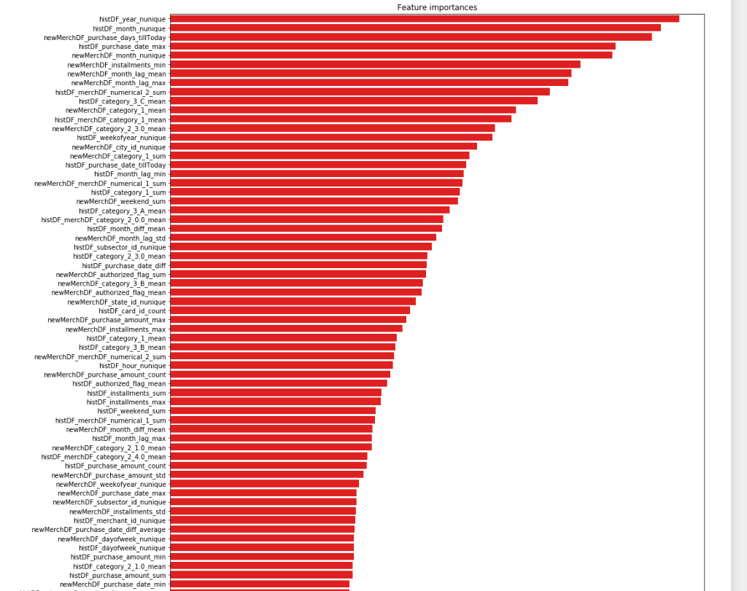
Machine Learning Model
Feature Importance

Slide 51
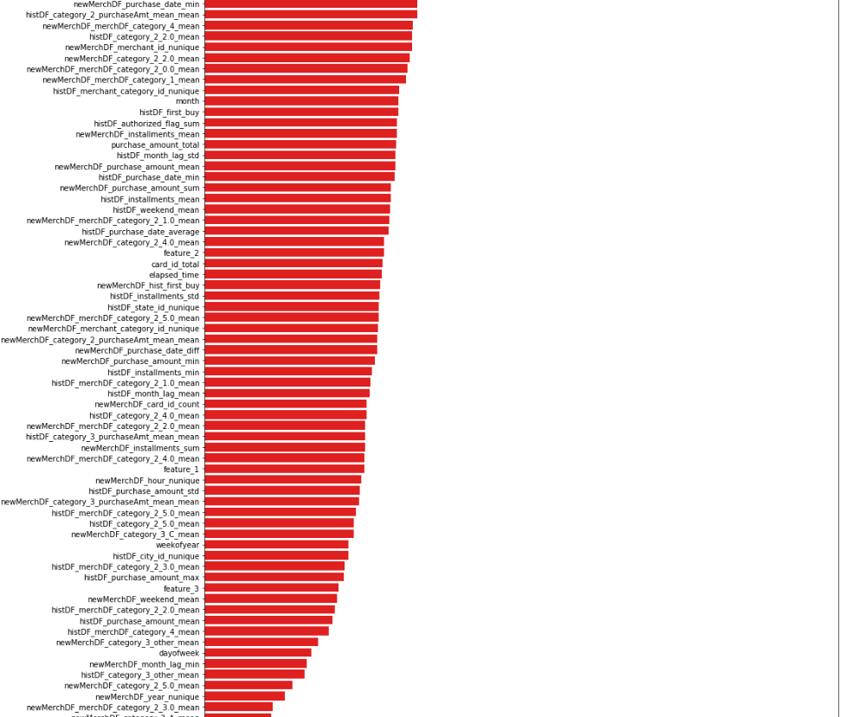
Machine Learning Model
Feature Importance

Slide 52
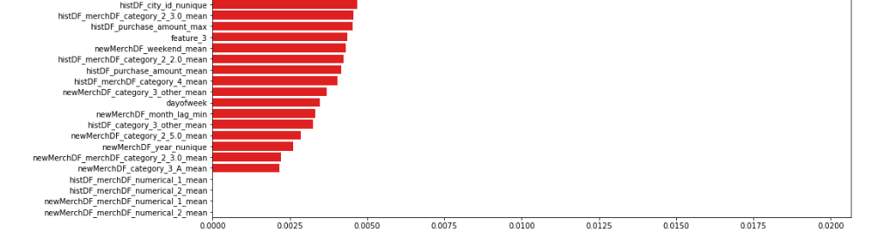
Machine Learning Model
Feature Importance

Slide 53
Conclusion
Top five features impacting model impacting loyalty score
histDF_year_nunique -- number of unique year in a card ID transactions in Historical transactions dataset
Card ID with more number of unique year means the card is actively used and hence has most impact on loyality score. As number of unique year decreases which means card ID is less active.
histDF_month_nunique -- number of unique months in a card ID transactions in Historical transactions dataset
Card ID with more number of unique month means the card is actively used and hence has most impact on loyalty score.
newMerchDF_purchase_days_tillToday -- number of purchase days from last purchase date in new merchant transactions dataset
As the number of days since last purchase made impacts loyalty score
histDF_purchase_date_max -- Most recent purchase date of card ID in Historical transactions dataset
As the number of days since last purchase made impacts loyalty score
newMerchDF_month_nunique -- number of unique months in a card ID transactions in new merchant transactions dataset
Card ID with more number of unique month means the card is actively used and hence has most impact on loyality score.
Recommendation -
If the loyalty score of a card is low, then discount in top important category can sent to card holder.
Loyalty score can be monitored monthly and if the loyalty score decrease then a discount in most important category can set to card holder.

